Slide 1

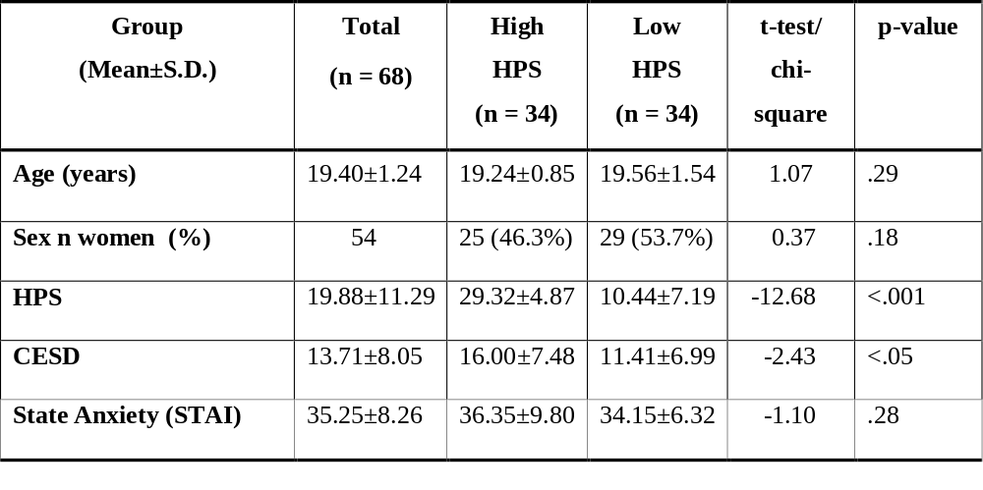
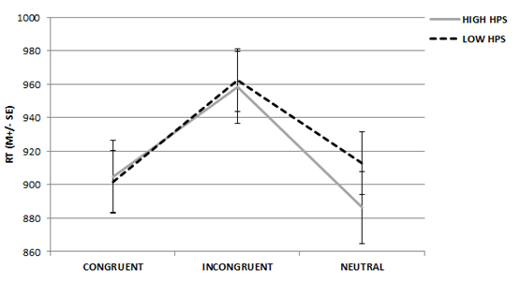
THE ROLE OF NEGATIVE MOOD INDUCTION ON WORKING MEMORY CAPACITY IN INDIVIDUALS PUTATIVELY AT RISK FOR BIPOLAR DISORDER: A PILOT STUDY
Isabelle E.Bauer1, Gabriele Jordan2, Jair C.Soares 1, & Thomas D. Meyer1*
¹UT Center of Excellence on Mood Disorders, Department of Psychiatry and Behavioral Sciences, Houston, USA
²Institute of Neuroscience, Newcastle University, Newcastle upon Tyne, UK
*Corresponding author: Isabelle.E.Bauer@uth.tmc.edu
BACKGROUND
RESULTS
Bipolar disorder (BD) is characterized by cognitive deficits.
Individuals at risk for BD do not display such deficits but might do so under cognitive or emotionally stressful conditions.
There may be a bias towards negative information in both adults with BD and unaffected offspring of patients following a negative mood induction.
VAS scores revealed significant changes in happiness and sadness ratings suggesting that the negative mood induction was successful
Stimuli incongruency, high cognitive load and mood induction increased response times.
Mood induction did not differentially affect at-risk individuals.
At-risk individuals generally reacted faster to neutral stimuli compared to those at low risk.
OBJECTIVE
CONCLUSIONS
To examine working memory capacity under mood induction in individuals at risk for BD.
We replicated former results related to the DTP but we did not find evidence for the hypothesis that individuals putatively at risk for BD will be more affected by negative mood when doing such a cognitive task.
Replication using a larger sample is needed which should also examine whether changes in positive mood might more relevant in the context of risk for mania.
METHODS
Using the Hypomanic Personality Scale (HPS) 68 participants (out of an initial pool of 148 students) were divided into groups at high and low risk for BD.
Participants completed twice a Dual Task Paradigm (DTP) task assessed under high and low cognitive load prior to and following a negative mood induction.
REFERENCES
Gotlib, I.H., Traill, S.K., Montoya, R.L., Joormann, J., Chang, K., 2005. Attention and memory biases in the offspring of parents with bipolar disorder: indications from a pilot study. Journal of Child Psychology and Psychiatry 46, 84-93.
Meyer, T., Blechert, J., 2005. Are there attentional deficits in people putatively at risk for affective disorders? Journal of affective disorders 84, 63-72.
Kwapil, T.R., Miller, M.B., Zinser, M.C., Chapman, L.J., Chapman, J., Eckblad, M., 2000. A longitudinal study of high scorers on the Hypomanic Personality Scale. Journal of Abnormal Psychology 109, 222.
Interaction between risk for bipolar disorder (HPS high versus low) and stimuli condition in the DTP

